Slide 1
Copyright for Startups
Session 2: Copyright In Motion
O’Reilly Tools of Change for Publishing
2012
Skott Klebe
Copyright Clearance Center
sklebe@copyright.com
Twitter: @skottk
Ed Colleran
Copyright Clearance Center
ecolleran@copyright.com
@ecolleran

Slide 2
Session 2:
The Changing World
of Copyright
Notes:
Welcome back. In this second session, we’re going to look at copyright overseas, and then we’re going to look at some innovation success stories, as well as some that were less successful.

Slide 3
Copyright Outside the United States

Slide 4
Agenda
Global Considerations
International copyright
Licensing models and mechanisms
Legislative activities

Slide 5

Global Considerations
There is no one defined body of law
Copyright operates on the basis of relations between nations
Laws vary by country
Notes:
There is no such thing as international copyright law to refer to - instead it is based on treaties that set standards for protection and use
Laws in each country have to be considered.
Every country has its own laws and practices. At the very basic level, this means that if you as a company are sued in Australia for a copyright infringement that takes place in Australia you will need to obtain an Australian copyright attorney, follow the rules of the court in Austalia, etc., in the same way that if you are sued in the U.S., you would need a U.S. copyright attorney.
And, if you have a similar case in different countries, you may get a different result. For example, when Google was sued in France by a French publisher for scanning published books, Google lost. When Google was sued in the U.S. by rightsholders Google was able to come to a settlement agreement with rightsholder groups, which is currently in the process of judicial review. CCC recently had an excellent program on this very subject, so if you are interested in more information about this topic, visit the Education section on copyright.com

Slide 6

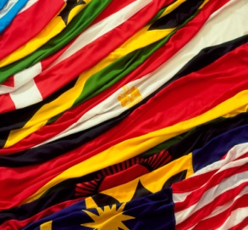

International Treaties
BERNE
WIPO
TRIPS
Implementation Principles
1) Territoriality in each country
2) National treatment
3) Minimum protection
Notes:
1. International copyright issues are guided by international treaties.
Several international treaties form reasonably coherent protection that set standards of protection and use and each country does its best to implement within these standards.
2. The first and most important treaty…and the oldest is the Berne Convention- est. in 1886 –
- has been signed by 165 countries (inc. US in 1988) - nearly 24 countries since 2000
Berne requires that copyright protection be “formality free” Which means that it shouldn’t be difficult for the rights owner to have protection. In other words, the treaty stipulates that a formal registration process isn’t required to be afforded international copyright protections
3. WIPO ( or the World Intellectual Property Organization)
One of the (52) specialized organizations of the United Nations, and it is based in Geneva, Switzerland
The advent of the digital technology and the internet led to the creation of two new international treaties under the auspices of WIPO. They are called the “internet treaties”
They basically recognize that transmission over the internet is another exclusive right of the rights owner and they also categorize the removal of rights management information (embedded identifiers) or any other technological protection measures as infringements of copyright
4. TRIPS - Bearing in mind the huge economic importance of creative industries, it is no wonder that countries started to negotiate about intellectual property protection in the trade environment in the 1980s. It incorporates the stipulations of the Berne Convention, adding computer programs and databases among protected works.
5. Also important to understand are the implementation principles of these treaties.
Territoriality within each country assumes that each country is responsible for law governing uses in their own country.
The standard of “national treatment” in the Berne Convention means that each country needs to treat foreign works at least as well as national works
6

Slide 7
National Law Perspectives
  Copy
  Distribute
  Transmit
  Public performance
  Entitled to compensation for use
Economic
  Authorship
  Attribution
  Integrity
  Publication
  Expression of personality / humanity
Moral
Notes:
There are two approaches to national copyright law,
Economic and
Moral. What is the difference between the two?
4. Copyright law grants exclusive rights to authorize or prohibit certain exploitations of copyrighted works.
The word “exclusive” is intended to mean that the rights owner can decide who, when, where and under what conditions his works can be used.
Works can be used in many different ways: they can be copied, distributed, transmitted over the network, performed publicly, and many, many more.
All of these uses are covered by economic rights – that is, the entitlement to be compensated in money for any exercise of one of these rights, and the entitlement to buy, sell, license and do other things with the copyrighted work as if it were a piece of tangible property.
As a result, a user needs permission from the rights owner or his representative to use works within the scope of any of the exclusive economic rights.
5. Moral rights on the other hand refer to the notion that a copyrighted work is an expression of the personality and humanity of its author or creator
At its most simple, this means that the name of the author needs to be mentioned in connection with the work. There are a number of moral rights that belong to the original creator, including
The right to claim authorship,
The right of attribution (or not),
The right of integrity (that is, the right to forbid alteration, mutilation or distortion of the work, even if the change is not derogatory), and
The right of first divulgation (publication).
The moral rights in a work ordinarily cannot be transferred to a third party even if the economic rights of the copyright are transferred. In many countries, they can’t even be waived legally (though, of course, a buyer will do everything he can to convince the author not to exercise the moral rights).

Slide 8
National Law Approaches
Anglo American
  Economic theory of copyright
  Arrangement between society and creators
  Economic incentive
  to create
Continental
  Personal rights reside with author (moral rights)
  No transfer of rights
  Napoleonic Code and its descendants
England, Canada,
Australia, New Zealand, India, United States
Western European Countries,
China, Japan
Notes:
1. What is the approach in the US? How does that differ from other countries?
2. ANGLO AMERICAN – is the approach in the US
This is the economic theory just discussed– that is, there’s a deal between society and creators . . . society provides a limited monopoly to the creator, specifically translatable into money, as an incentive for the creator to create.
The economic theory exists in pretty much all countries to a greater or lesser extent, seeking to create a balance between the needs of users for access and of rights owners to be compensated.
3. CONTINENTAL
This is the moral rights theory of copyright that is founded on the notion that human creations are an expression of the human personality and, as such, belong without compromise to the creator of the work, who can choose to allow or not allow others to use her creations.
The Continental or moral rights theory is seen as primarily a French creation, are also subscribed to by most E. Asian countries.
Where the economic theory is usually seen as an Anglo-Saxon creation – most highly developed today in the United States, but very definitely an important component of the law in Canada, the UK and elsewhere
8

Slide 9
Striking a Balance
Fair Dealing
Fair Use
Exceptions and Limitations
Notes:
There are complexities when dealing with copyright internationally. Are there any situations that allow use of content without requiring permission or licensing?
Certain uses are permissible directly on the basis of the law, and in those cases no prior permission is needed from the rightsholder.
These cases are called “limitations and exceptions” in most European countries.
Skott already covered “Fair Use”.
In the United Kingdom and Ireland, the notion of “fair dealing” covers areas where prior permission is not needed.
The criteria for what is considered to be fair are listed in the law, without mentioning every specific possible use.
Certain library uses, such as making of preservation copies, serve as an example of a typical exception.
Private copying is another area that may be covered by an exception; however legislation needs to provide compensation for private use in the countries of the European Union.

Slide 10
Licensing Mechanisms
Notes:
Dru: All this being said, to make it easier to comply across borders, I imagine that certain licensing mechanisms must be used…….

Slide 11
International Permission Considerations
Multiple licenses
Individual permissions
Local laws
Collective management
Translation issues
Notes:
Permissions to be considered
When sharing content in this multinational environment you need to consider International Treaties in conjunction with the national laws of the country where the content will be shared. T
The Licenses and subscriptions your company has substantially invested in for the benefit of their employees need to be considered.
And the company’s copyright compliance policies must also be factored into any decision made by an employee.
Must consider
Translation Rights: Must accommodate non-English speaking customer – in France for example
Publisher agreements don’t always offer the same content usage rights in different locations.
Challenges when pursuing permissions in different countries
Licenses can vary from country to country and customer to customer.

Slide 12


Collective Licensing
CCC
CLA
JRRC
VGBK
VG
Wort
Notes:
International Permissions are often handled via collective licensing
In collective licensing, the Collective Mgt Organizations (CMO) issues licenses to use copyrighted content on behalf of those rights owners who have given it.
Txt, photography, illustrations, film, music, etc
CMO’s get their licensing authority from mandates given by national rights holders, AND, through bilateral agreements with the CMO’s in other countries, licensing access to their own repertories. CCC, for example has many bilateral agreements with other collective licensing organizations around the world.
The CMO for txt licensing is generally the local Reproduction Rights Organization (RRO)
In the United states collective licensing through CCC is based solely on non-exclusive contracts. Authors and publishers determine which works are to be included and they also set the prices for those works.
In the United Kingdom it is CLA (Copyright Licensing Agency LTD.)
In Japan there are three different cmo’s , one being the Japan Reprographic Rights Center
And in Germany is it VG Bild-Kunst and VG Wort
Over 400 CMO’s and 60 RRO’s

Slide 13
Licenses
Statutory
  Set by law
  Involuntary for both
  Blanket or machine levy
GERMANY
Blanket Mandates
  Binds the rights owner
  Voluntary for the user
UNITED KINGDOM
CANADA
Voluntary
  Voluntary for both
  Repertory
  Transactional
UNITED STATES
Notes:
1. There are different licensing models used around the world and adopted by the CMO’s/RRO’s
Statutory –i.e. Germany,
Blanket mandates –i.e. UK
Voluntary models –i.e. US
2. Statutory licenses are those that are set by law and effectively involuntary for both sides of the content use-essentially all rights owners works are covered and all users have to pay-there is no opt out on either side.
Germany is known to have a Machine or Media levy-tax on equipment that can reproduce copyrighted works, as well as other countries on the continent. Photocopies, Printers, CD Burners are a few examples of taxed machines. No l;evy for digital
3. Blanket mandates, on the other hand, are essentially a “no holes-statute” which provides the licensing agency with the right to issues licenses to all works in the country(including foreign works) unless the rights owner elects to opt out. These mandates bind the rights owner but is voluntary on the part of the content user. The user elects to purchase a license.
The United Kingdom and Canada are known to impose blanket mandates on the use of copyrighted content.
4. Voluntary systems areas the name indicates, voluntary on both sides of the content exchange-so both the rights owner and the content user can opt in or out of the license.
Within this category there are basically two kinds of licenses –a Repertory license—which is a subscription fee for unlimited use within the scope and terms of that license for a specified period of time. Or, a transactional license - which is commonly described as a “Pay as you go” or individual use.
The United States is known to have an entirely voluntary licensing system. CCC needs to sign up Rightsholders in any programs in which they would like to participate.
Interestingly, many countries have adopted a voluntary system for licensing digital content, even where photocopying is still covered under a statutory or blanket scheme
13

Slide 14
Licensing Methods
Repertory
Transactional
Point of content

Slide 15
In Summary
Sharing content globally is increasingly prevalent
Publishers must take into consideration all variables, including local laws and treaties, when developing permission options for their customers
Permission options must be clearly defined for global use
Licensing schemes can vary by country

Slide 16
Government Activities
Notes:
Here are some recent local government activities that are, will or can effect copyright and how people share content

Slide 17
Recent International Government Activities
UK - Hargreaves Report
  “UK IP framework is falling behind”
  Acts as a regulatory barrier
Recommends changes to support
  Text mining
  Personal use copies
  Changes to academic copying
Notes:
Liberalizing tendencies
Hargreaves Report – presented report, now in copyright consultations, Parliament action in early Spring
On May 18, an independent commission led by Professor Ian Richard Hargreaves issued its report on UK intellectual property law entitled “Digital Opportunity: a review of intellectual property and growth” (the “Report”). In addition to copyright, the Report also covers other areas of IP, including patents and designs.
The Report concludes, broadly,
UK intellectual property framework, especially with regard to copyright, is falling behind what is needed” and goes further,
UK copyright law in many ways acts as a “regulatory barrier” to impede innovation and growth, particularly of new technologies and business models that rely on the ability to access, search, mine and otherwise use copyrighted content.
In case it comes up in ?’s(Hargreaves is Professor of Journalism at the Centre for Journalism Studies (JOMEC) and chair of digital economy, at Cardiff University, Wales, UK)
an advocate – a shill, even – for Google because many of the “improvements” he recommends are things that Google would like to see . . . . and Hargreaves gives very little, if any, justification for many of them. Example: he says that text and data mining should be an exception to copyright, and yet he never explains how that can happen without forcing RHs to open their computer files.

Slide 18
Recent International Government Activities
Canada - Bill C-11
  Formerly Bill C-32
  Expand Fair Dealing in academia
  Publishers concerned about effect on education sales
Notes:
Liberalizing tendencies
Canadian C-11-Looked at in last session as C-32, and now C-11, And is expected to pass in some form
Expands fair Dealing within education
Rightsholders and RRO’s concerned that this could seriously effect commerce and copyright

Slide 19
Recent International Government Activities
Spain
  New regulations supporting site shutdown for infringement
  Eliminated digital private copy levy
    No more levies for photocopiers, CD burners, printers, etc.
    Replaced with government payment based on the budget
    Could greatly reduce royalties to rightsholders
Notes:
Spain – recent decisions- The new government approved the composition of a commission which is a key part
in the new regulations against online piracy.
Ultimately this means
that rightholders will now have the chance to request the closing of websites
where their copyrights are being infringed.
2. They announced the abolition of the digital private copy levy, and its replacement
by a new compensation system that will be determined in the next few months.
It appears that the Government will pay the compensation
using public money from the national budget –instead of manufacturers/ importers/
distributors (and ultimately consumers) having to pay for it-via the levy.
The annual amount of the compensation to RightsHolders will be something between 37 and 42 million euro
(for all the works types) which would be less than half of what the various CMOs
are collecting now per year.

Slide 20
Recent International Government Activities
France - HADOPI
  Creates a mandate for internet users to prevent unauthorized transmission of copyrighted materials
  Included 3-strikes provision
    Suspend users internet connection for up to year
  Parts found unconstitutional after passage
Notes:
HADOPI
The French HADOPI law or Creation and Internet law
A law promoting the distribution and protection of creative works on the internet was introduced and approved by the French Constitutional Council during 2009 as a means to control and regulate internet access and encourage compliance with copyright laws.
Mandate
To ensure that internet subscribers "screen their internet connections in order to prevent the exchange of copyrighted material without prior agreement from the copyright holders" (Art. L. 336-3 of the bill). HADOPI also retains mandates previously attributed to the ARMT.
Punishment after 3 strikes
The ISP is required to suspend internet access for the offending internet connection, that which is the subject of the claim, for a specified period of from two months to one year.

Slide 21
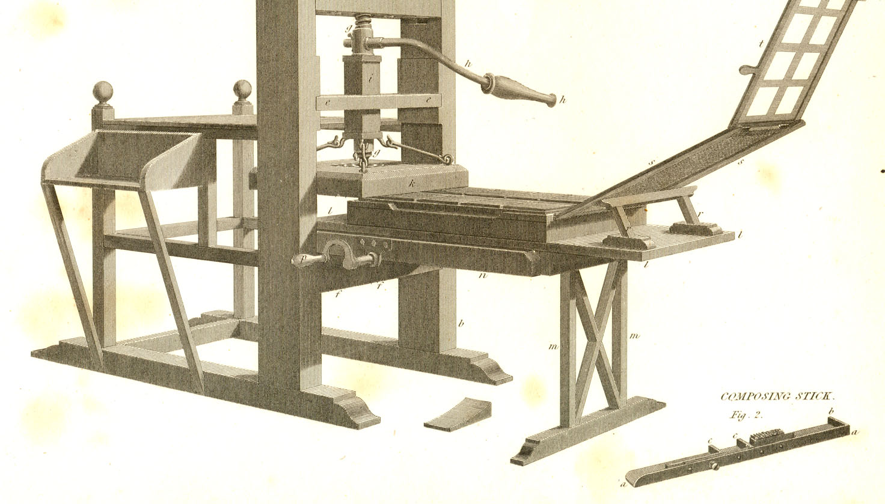
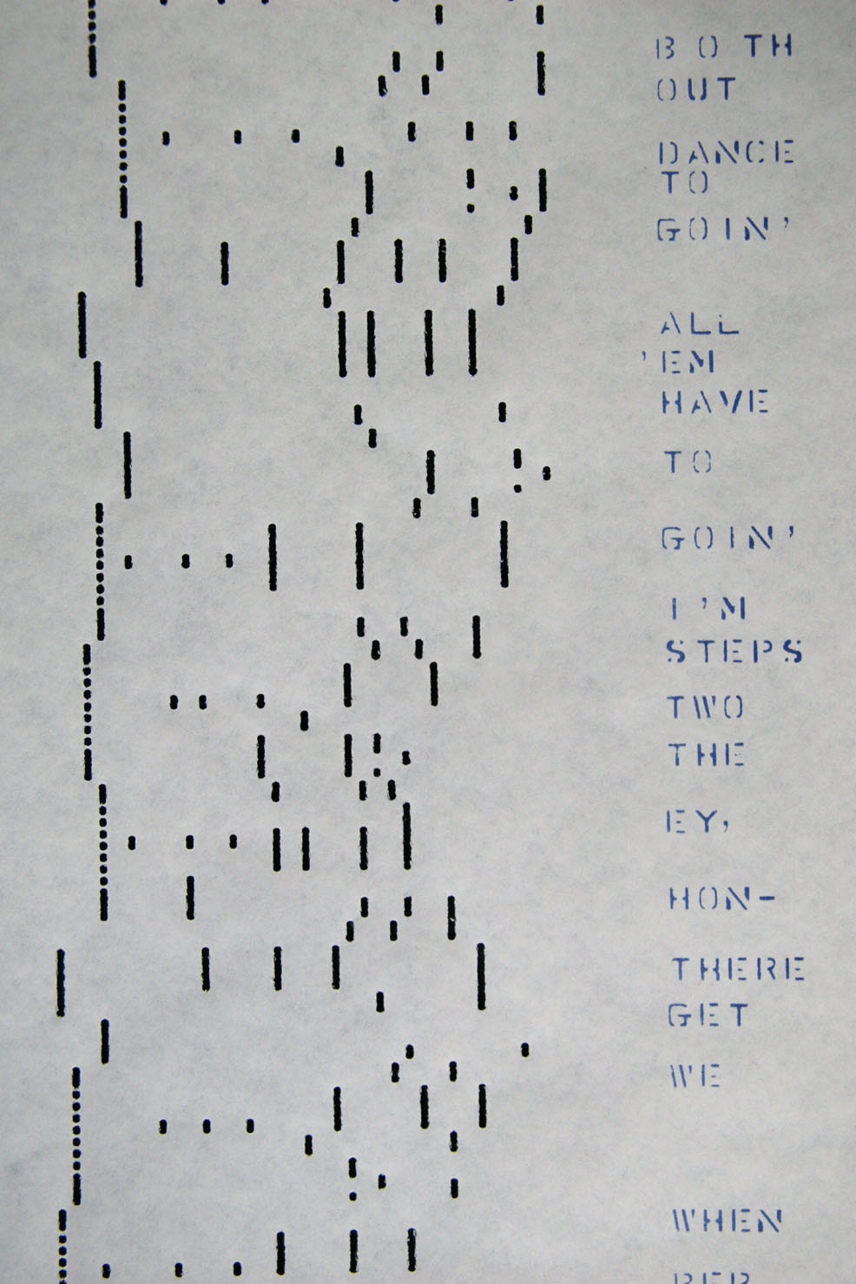
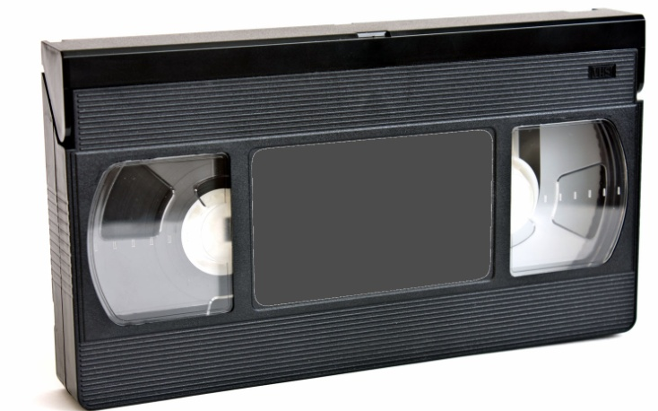


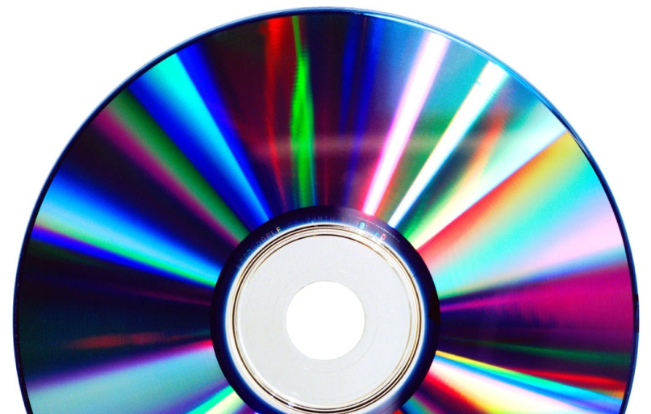
Copyright in Motion
How copyright adjusts to the changing world

Slide 22
Innovations that changed copyright
The printing press Movable type Photography The phonograph Player pianos Radio Motion pictures Television Photocopy machines Cassette tapes VCR’s Cable TV Satellite TV The Internet E-Mail The World Wide Web Peer to Peer E-Books Social Networks BitTorrent
Notes:
Here’s a partial list of technologies that have wrought significant changes to copyright.
In general, though, the path of change is neither gentle nor straight.

Slide 23
Innovation
New media
New technology
Litigation
Finding for
Legislation
Consequences
Intended
Unintended
Finding against
Notes:
Of course, this is an oversimplification, but I think that it’s a helpful representation. Legislatures aren’t required to wait for issues to bubble up through court systems, but their reaction times are slow enough that it’s hard to count on them for prompt action.

Slide 24
Innovation
Notes:
There are many examples we could choose to talk about, but let’s settle on one.

Slide 25
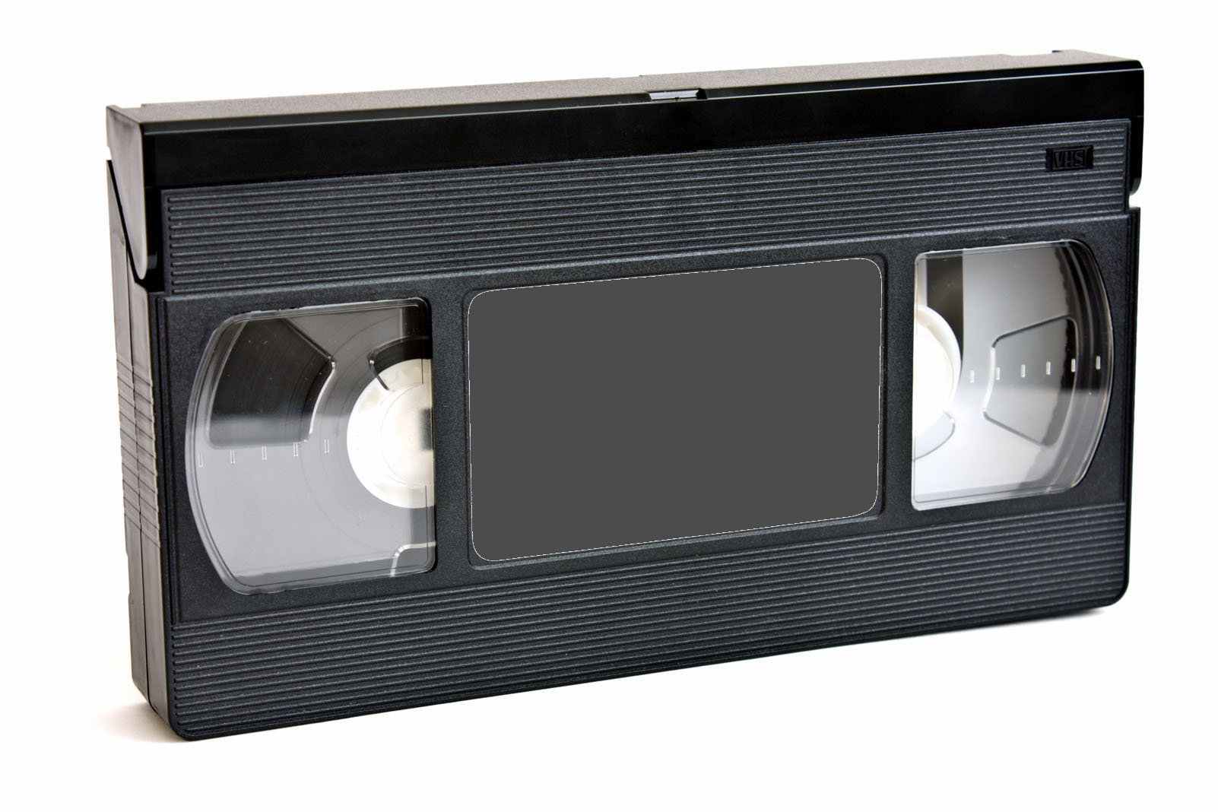
Notes:
The humble videotape. Or, more specifically and even more humbly,

Slide 26
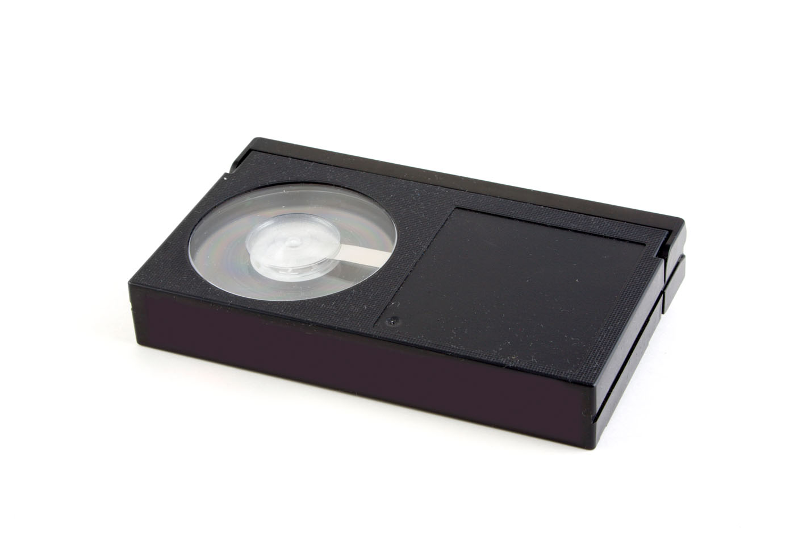
Notes:
The Betamax tape.
The Sony Betamax was the first video cassette recorder intended for the consumer market.
It could record what was in 1975 considered high-quality video, up to sixty minutes’ worth, and it only cost a thousand dollars!
It used a proprietary format designed by Sony, which wound up losing in the marketplace to the VHS format introduced by JVC,
Which is still around today. At least in my house.
Even though it lost in the marketplace, it was a winner in the court system. The Betamax technology was the center of one of the most important legal battles in the recent history of copyright. Let’s pause for a moment, and zoom in on it for a while.

Slide 27
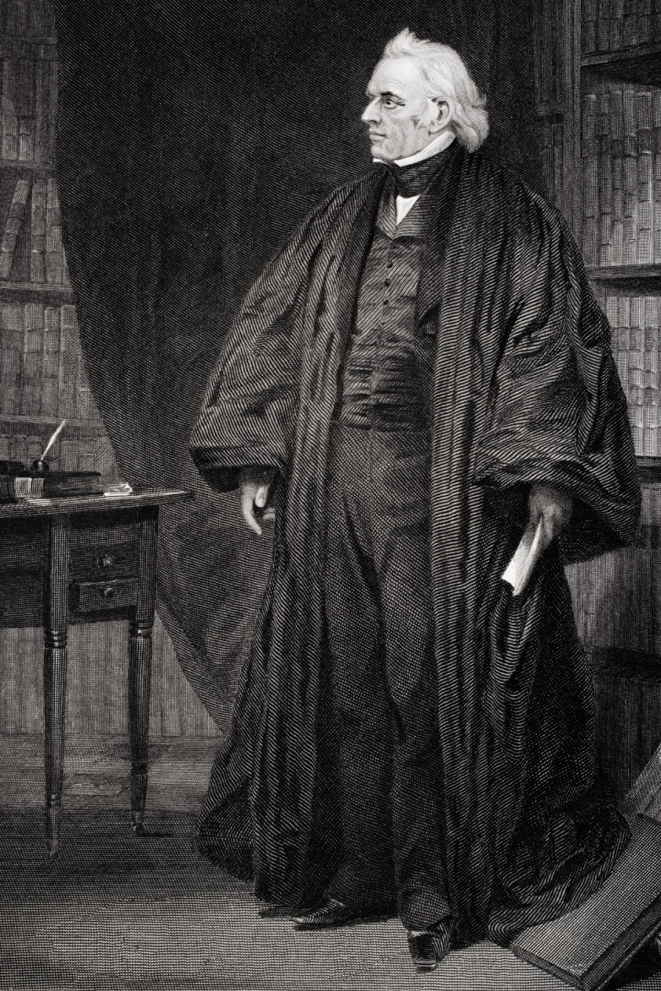
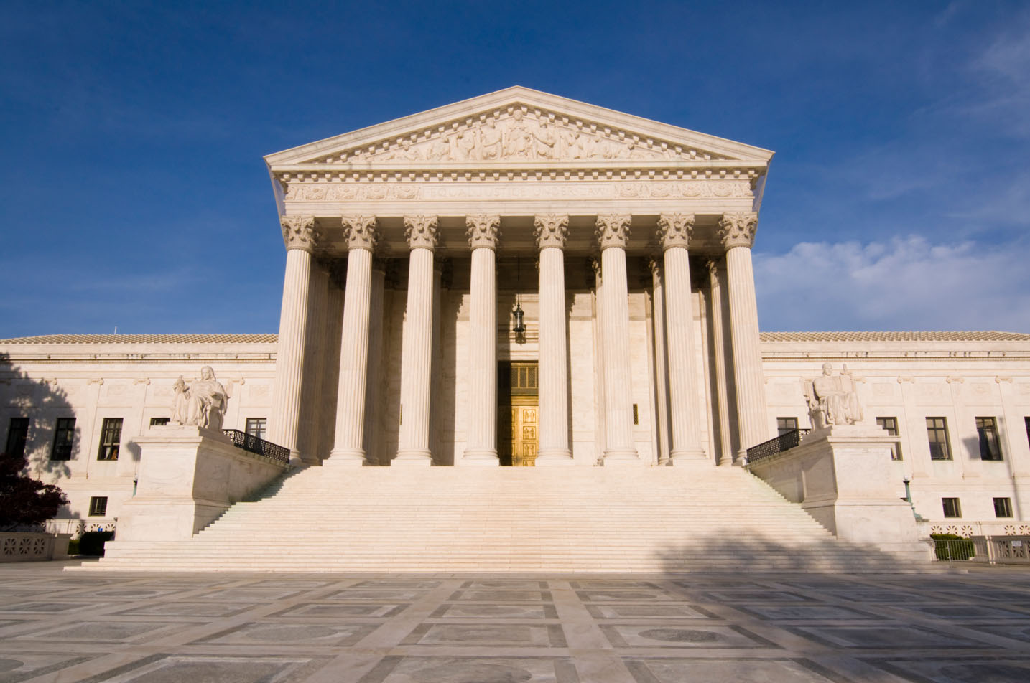
Litigation
Notes:
Sony Betamax was a technological innovation that enabled a new type of content use – the personal-use temporary copy.
As often happens in copyright, the new product spurred litigation by rightsholders concerned that the new use infringed their rights under copyright.

Slide 28
Betamax Timeline
1975
Sony Betamax VCR available in US
1976
Universal brings suit for copyright infringement
1979
District Court rules for Sony
1981
Ninth Circuit rules for Universal
1984
Supreme Court rules for Sony
Notes:
Almost ten years from the introduction of the product to the end of the litigation over whether it was legal to use it.
One of the interesting things about this sequence of trials is that each appeal reversed the prior finding. Overall, the thoroughness of the litigation helped establish the reasoning in Sony for later trials on other technology.

Slide 29
Universal City Studios, Inc. et al. v.
Sony Corporation of America et al.
District Court
Notes:
This was a novel case in many ways. The trial straddled the implementation of the Copyright Act of 1976, which meant that the judge considered the issues under the 1909 act for actions that happened earlier, and the 1976 act for actions after it went into effect.
Furthermore, it was the first time that home taping had come up in a copyright case. In the prior history of copyright, the most significant cases had involved questions of obviously commercial behavior by companies and corporations, or by artists and creators.

Slide 30
Universal’s argument:
Contributory Infringement
District
Court
Home copying is infringement
By selling Betamax, Sony is promoting infringement
So are retailers and advertisers who help sell it
Notes:
The core of the case is an argument around contributory infringement – that Sony was urging its customers to commit infringement.
There were other arguments as well – Universal et al hired private investigators to go into stores and witness salespeople demonstrating that you could copy shows, and things like that. But this is the heart of the argument, because it strikes right at the innovator’s problem – being able to market a service or product whose innovation represents a new way of using or consuming copyrighted content.

Slide 31
Sony’s response:
Time Shifting is Fair Use
Customers use Betamax primarily for “time-shifting”
Most recordings were taped over after viewing
Time-shifting caused no harm to copyright owners

Slide 32
Sony and Fair Use: Four Factors
Nature of Use | Nature of Material | Extent of Copying | Market Effect
Noncommercial Private | Broadcast for free | No harm | No harm to date, or likely in future
Verbatim Non-transformative | Creative Entertainment | Copied entire work
Compelling fair use argument for time-shifting
  Key finding: Lack of Harm
Notes:
The judge in this case examined the fourth factor, market effects, first, and found that no harm had occurred because of home copying, and that the trial arguments for future harm at were speculative and contradictory. In the absence of harm, the factors in favor of fair use became much stronger.
Overall, the judge noted that this was the first fair use case regarding video technology, and that Congress had intended fair use to be flexible in order to adapt to new particular changes. He ruled that home recording was fair use.

Slide 33
Matter of First Impression
First time that courts had considered home taping with respect to copyright
Judge looked outside copyright to patent law
  Significant Non-Infringing Use
SIGNIFICANT
NON-INFRINGING
USE
Universal City Studios v. Sony Corp.
Notes:
This is a very important concept. Let me emphasize that:
OK. The significant non-infringing use test has become important long-standing doctrine. As innovators, we have

Slide 34
Judge’s Finding: Sony on All Counts
District Court
Time shifting is fair use and is not copyright infringement
Can sell a product with a SNIU without contributory infringement
Since time-shifting is a SNIU, Betamax does not create liability

Slide 35
Universal City Studios, Inc. et al. v.
Sony Corporation of America et al.
Ninth Circuit
Notes:
Universal appealed the decision.
The appeals court disagreed with the trial court on almost every point.
The Ninth Circuit ruled that home recording infringed the exclusive right of reproduction
District Court erred in reading the legislative history otherwise
Reversed District Court on nearly every finding
Every point of fair use analysis
Vicarious and contributory infringement
Wrong to apply “substantial non-infringing use” standard
ion.

Slide 36
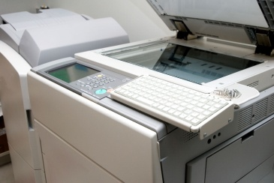

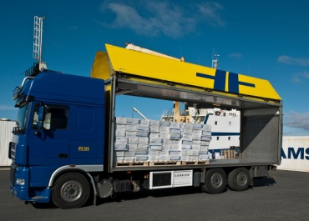


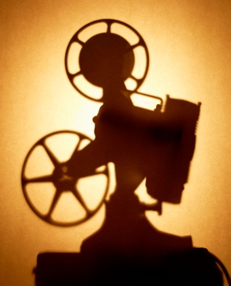
Sony and Exclusive Rights
Reproduce
Create a derivative work
Distribute copies
Perform publicly
Display publicly
Perform digitally
Notes:
The trial judge looked at the exclusive rights in the Copyright Act, as well as the discussion in Congress about them, and concluded that there was no intent to create an exclusive right for time-shifting. Remember that the list of exclusive rights in US copyright law is illustrative, and subject to interpretation.
The appeals court said, it’s right there in front of you – the exclusive right of reproduction.
Thus, there was no reason to create a new standard of SNIU, since time-shifting was simple copying.

Slide 37
Contributory Infringement
Ninth Circuit
VCR’s record TV Shows
Nearly all TV shows are protected by copyright
There is no substantial non-infringing use
Copying a TV show is almost always infringment
Universal City Studios v. Sony Corp
Notes:
However, the appeals court went on to attack the non-infringing use argument as well.

Slide 38
Sony Corporation of America et al. v.
Universal City Studios, Inc. et al.
Supreme Court
Notes:
So Sony appealed the decision

Slide 39
Sony Corporation of America et al. v.
Universal City Studios, Inc. et al.
Fair
Use
Substantial
Non-infringing
Use
5-4
Universal City Studios v. Sony Corp.
Notes:
The Supreme Court reversed the Appeals court in an opinion that strongly upheld the District Court ruling.
The majority opinion found more clearly in favor of fair use, highlighting the testimony of Mr. Rogers that time shifting was a real benefit to families.
It also upheld and emphasized the SNU standard, citing both fair use and the testimony of sports and religious programmers, as well as public television, that they had no objection to time shifting.
The endorsement of the reasoning in applying the SNU standard was perhaps the most important outcome, as this Sony standard has become an important test of further innovations in the years since.
The majority opinion was emphatic, but the ruling overall was as narrow as could be. The minority opinion held as strongly in favor of the appeals court ruling. The history of the last thirty years of technology in the media could have been very different.

Slide 40
Key success factors for Sony
Substantial
Non-infringing
Use
Strong argument
  Time-shifting as fair use
Patience and resources
Meticulous approach
  Documentation of user behavior
  Good-citizen behavior
Copyright owners conceded lack of harm
Fair
Use
Notes:
Sony had the wherewithal to fight for years, but also to create a very careful case for legitimate use of the Betamax VCR.
They could show patterns of customer usage that confirmed their fair use arguments.
Also, as a company they did not have to deal with widespread evidence of copyright infringement from within their organization.
Finally, though, the television programming industry was not nearly as prepared for the fight as the studios are today.
It’s hard to imagine a trial today in which copyright holders conceded that there was no current evidence of harm!
Sony’s success in this case was a big mobilizing factor for the media industry.

Slide 41
Sony’s Legacy
Sony is not an anti-liability blanket!
Numerous file cases since invoked Sony without success
Sony
Napster
Grokster
Notes:
Napster and Grokster were among the most famous recent music-sharing services that lost at court on copyright grounds, and got shut down.
However, there were many more.
Sony’s SNIU standard is usually invoked in such cases to argue that the new service, like the Betamax, gives a substantial benefit, and as such does not create contributory liability for the provider.

Slide 42

Napster
File sharing and substantial non-infringing use
Sony
Napster
Grokster
Notes:
Let’s start with Napster.
“Original” Napster
Operated from 1999 to 2001
Peer to Peer file sharing network
Optimized for MP3 files
Central directory of file-sharers operated at Napster

Slide 43
Napster Technology
2. Stores name and location
Location Database
1. Uploads list of songs
User 1
User 2
2. Downloads file from User 1

Slide 44
Napster litigation
District Court
Sued by Metallica, Dr. Dre, and at least 15 record companies
Napster argued fair use and “substantial noninfringing use”
  “Space shifting” – transfer from device to device
  Support for independent bands
A & M Records et al. v. Napster et al.

Slide 45
Napster and Fair Use: Four Factors
Nature of Use | Nature of Material | Extent of Copying | Market Effect
Commercial benefit to users Verbatim Non-transformative | Entertainment | Copied entire work | Affected album sales Harder to launch online music services
Compelling argument against fair use
  Half of users had 90% of music from Napster
  Heavy users said they bought less music than before
Notes:
Napster did not do well in the judge’s fair use analysis. The potential for financial harm to the copyright owner seemed substantial – the judge noted that 90% of the music on a typical user’s system came from Napster, with only 10% purchased.
The traditional counter to that would be to argue that the typical user would never have purchased all of that music in the first place, and that the opportunity to listen to more music – sampling – would actually increase buying.
However, evidence introduced at trial showed lower music purchasing among individual Napster users, and in geographical areas near colleges where Napster use was heavy.

Slide 46
District Court
Substantial Non-Infringing Use?
No evidence for “space-shifting” use
Minimal support for “new artist discovery” use
  Napster advertised availability of “major stars”
With its central database, Napster knew of extensive infringement
Napster lost, eventually shut down
  After changing hands
  And more litigation!
A & M Records et al. v. Napster et al. 1999
Notes:
Service description – Napster pointed to the availability of “major stars,” instead of “page after page of bands you’ve never heard of.”
Sony defense – can’t really argue that you’re offering a substantially noninfringing service when you have (or could have) ongoing evidence that your service is actually used for infringement.

Slide 47
Napster takeaways
Unprepared for litigation
  Services to support fair use argument created during litigation
  Difficulty documenting any non-infringing use
Good citizen?
  Internal communication referred to the software as enabling piracy
  "[W]e are not just making pirated music available but also pushing demand"
No good argument for legitimacy

Slide 48
Grokster
File Sharing and Substantial Non-Infringing Use:
Sony
Napster
Grokster

Slide 49
Grokster: Pure P2P
User 2
Publishes list of songs and location
Responds to queries
User 3
User 1
Publishes list of songs and location
Responds to queries
Publishes list of songs and location
Responds to queries
Notes:
Grokster was an improved generation of P2P file sharing software, using software licensed from another company.
Grokster supplied only the software itself – there was no central database.
Like other services such as Streamcast and Aimster, Grokster marketed itself as a replacement for Napster, even providing Napster conversion tools.
However, in Grokster all of the traffic was encrypted, so it was extremely difficult to find out what was being transferred at all.
You could say that the designers thought that the critical weakness of Napster was the central database, and tried very hard to make sure that the operators of these services could not know precisely what was happening on them.
Initially, this strategy was successful, as Grokster won at district court and appeals court.

Slide 50
Grokster at the Supreme Court
“Intent to bring about infringement”
“Made no attempt to reduce infringing activity”
“evidence underscores Grokster’s … intentional facilitation
Metro-Goldwyn-Mayer Studios Inc. et al. v. Grokster, Ltd., et al. 2005
Notes:
The majority decision held that Grokster was liable for contributory infringement, based on the way it was promoted, the fact that it was easy to find that most of the files available on Grokster were protected by copyright, and that Grokster had not attempted to take copyright protected materials down when notified – and in fact had designed their product in a way that made it difficult or impossible for them to do so.

Slide 51
How Grokster differed from Sony
No evidence that noninfringing use was substantial
Evidence that the company
  Knew of widespread infringement by its customers
  Promoted the service for infringing use
  Avoided removing copyrighted materials
  Sought to profit from the infringing use
No finding that the use was fair
Notes:
There were many arguments in both directions, and some people today still argue against the final Grokster decision.
What is clear, though, is that Grokster didn’t make it easy on itself. They relied on an interpretation of Sony that they didn’t have to do anything to manage direct infringement by their customers as long as they could contend that it was possible to use their service without infringing.
That eventually proved insufficient.

Slide 52
Litigation: Key Takeaways
Sony Betamax added an innovation “safe harbor”
  Substantial non-infringing use
  Awareness that some users are infringing does not itself create liability
Napster and Grokster showed “safe harbor” limits
  Helps if the non-infringing use is substantial
  Promoting a service for infringement can create liability for infringement
Innovations in media can require accommodations on all sides
  This can happen through negotiations
  When it doesn’t, it happens in court
Notes:
Much of the history of copyright in this century has concerned litigation over file sharing services.
Unfortunately, these early services didn’t demonstrate a real understanding of copyright and fair use, or thought that the law wouldn’t matter to them.
Just as an aside, I think that it’s going to be difficult to prove that you aren’t helping your customers break the law when you routinely discuss how your customers are breaking the law or promoting your service as a way to get things for free that you would otherwise have to pay for.

Slide 53
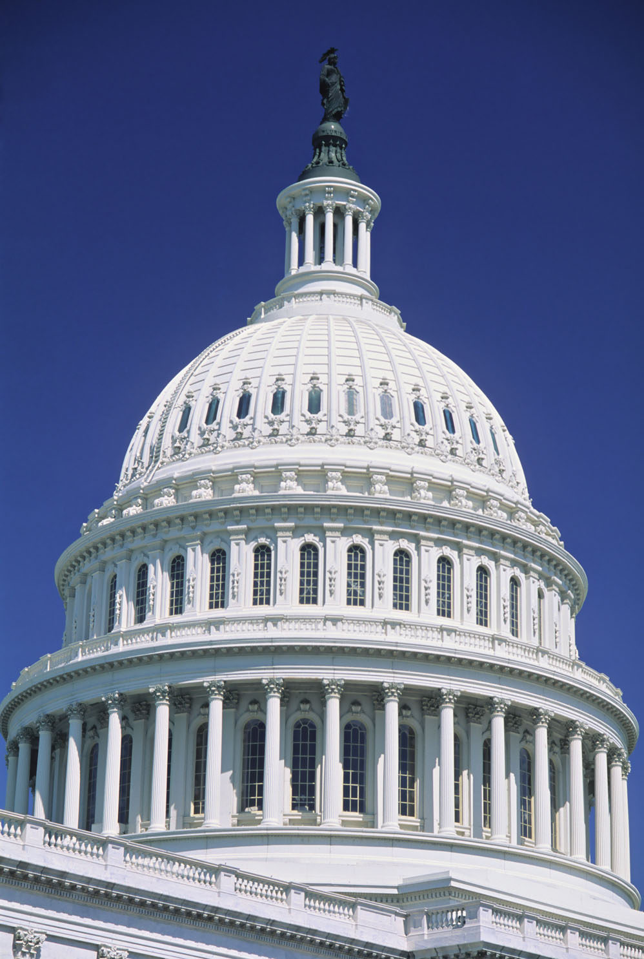
Legislation

Slide 54
Copyright and US Law
Constitution, 1783 Copyright Act of 1790 Berne Convention, 1886 Copyright Act of 1909 Universal Copyright Convention, 1952 Copyright Act of 1976 Semiconductor Chip Protection Act of 1984 Satellite Home Viewer Act of 1988 Visual Artists Rights Act of 1990 Architectural Works Act of 1990 Computer Software Rental Act of 1990 Semiconductor Internation Protection Extension Act of 1991 Audio Home Recording Act of 1992 Satellite Home Viewer Act of 1994 Digital Performance Right in Sound Recordings of 1995 Sonny Bono Copyright Term Extension Act of 1998 Digital Millennium Copyright Act of 1998 Digital Theft Deterrence and Copyright Damages Improvement Act of 1999 Technology, Education and Copyright Harmonization Act of 2002 Small Webcaster Settlement Act of 2002 Artists’ Rights and Theft Prevention Act of 2005 Family Movie Act of 2005 Preservation of Orphan Works Act of 2005 Vessel Hull Protection Amendments of 2008 Webcaster Settlement Act of 2008 Webcaster Settlement Act of 2009 Copyright Cleanup, Clarification, and Corrections, Act of 2010
Notes:
When you look at this list, you can see some aspects of both. Berne, the Acts of 09 and 76 were years or decades long processes involving all kinds of stakeholders. Some of these had much narrower sets of stakeholders and beneficiaries.

Slide 55

When does Congress get involved?
To respond to technological change
To address other drivers
  International law
  Clarifications and harmony
  Changes in case law
Eventually
Never?

Slide 56
“Congress has the constitutional authority and the institutional ability to accommodate fully the varied permutations of competing interests that are inevitably implicated by such new technology.”
Sony Corp. v. Universal City Studios, Inc.
Supreme Court, 1984.
Notes:
When I show this to one of my lawyer friends, it gets a laugh. In many respects we’re still waiting for Congress to address issues raised in Sony, let alone more recent matters.

Slide 57
Copyright Law and Lag
Act | Problem | Enacted | Lag
Copyright Act of 1909 | International copyright, types of works, conflicting state laws | 1909 | Decades
Universal Copyright Convention | International copyright | 1954 | Decades
Copyright Act of 1976 | Copyright, radio, television, photocopy, conflicting state laws | 1978 | Decades
Berne Implementation | International copyright | 1988 | 102 years
DMCA Sonny Bono Term Extension | Infringement concerns, innovation, international law, term extension | 1998 | <10 years
COICA, PROTECT-IP/PIPA, SOPA | Digital copyright enforcement | Proposed 2010+ | <10 years
Notes:
But this is typical
For most of the history of the US, Congress has taken its time in considering new copyright legislation.
Planning for the ‘76 Act began in 1955.
The current state of urgency is relatively rare, but that’s the age of the internet –
if twice in ten years can count as acting in Internet Time.
It’s also clear even in this extremely abbreviated table that copyright is always a work in progress. Berne was ratified in 1886, but the US took a bunch of bites at the apple before it finally gave in and implemented Berne over a hundred years later.

Slide 58
Digital Millennium Copyright Act (DMCA)
Large and complex bill with multiple aims
Highly controversial
  Digital Rights Management (DRM) protections – anti-circumvention
  The “Safe Harbor” provisions, limiting liability for online service providers who comply with takedown requests
  Sonny Bono Term Extension act, considered at the same time
Notes:
Let’s focus on one of those changes in particular, the Digital Millennium copyright act, or DMCA.

Slide 59
DMCA – Five Parts
 | Title | Effect
I. | WIPO Treaties Implementation | Compliance with WIPO terms, including anti-circumvention of content protection
II. | Online Copyright Infringement Liability Limitation | “Safe Harbors” for online service providers
III. | Computer Maintenance or Repair | Fix a 1993 precedent, MAI Systems v. Peak Computer
IV. | Miscellaneous Provisions | Narrow fixes, library uses, webcasting
V. | Protection of Certain Original Designs | System of protection for some boat hulls
Notes:
The first two sections are the most important, unless you’re a boat designer who’s worried about competitors turning your hulls into molds for copies of your designs.

Slide 60
DMCA Opposition
“Corporatism squared off brazenly against the geeks, and handily won Round One”
Slashdot
“The Evil that is the DMCA”
tidbits.com
“The net effect of the bill will be to stifle tech innovation, hinder the development and growth of the Net, and hinder competition in the computer industry.”
Sun Microsystems Executive,
in CNET.com
Notes:
I gathered a few quotes to try to capture the spirit of the technical community’s opposition to the DMCA bill.
These objections focused on the anti-circumvention measures contained in Title I – whether you owned your content
Anymore.
Let’s take a look at how these horrifying prognostications turned out.

Slide 61
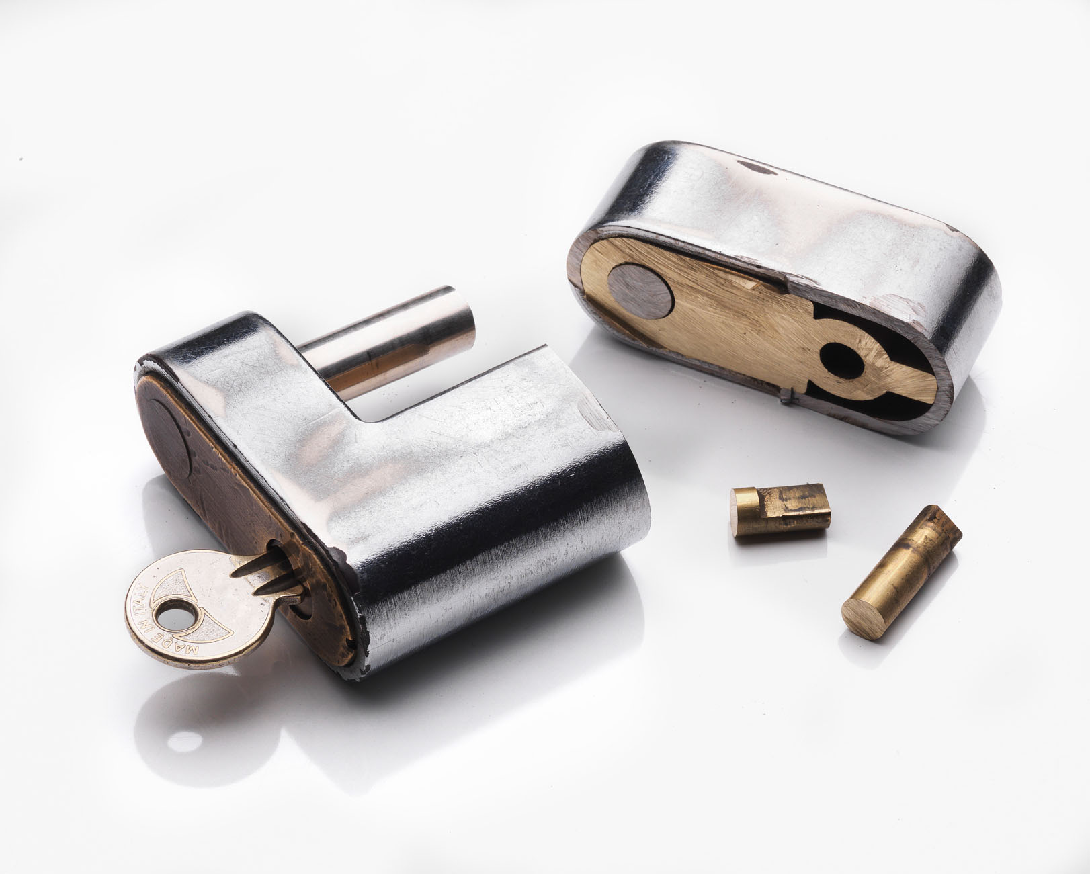
Anti-circumvention

Slide 62
Evolution of anti-circumvention
United States v. ElcomSoft and Sklyarov – 2001-2002
  Dmitri Sklyarov jailed under DMCA for implementing a tool to crack Adobe ebook security
    Acquitted in jury trial 2002
Lexmark v. Static Control Components – 2003-2004
  Attempt to use DMCA to prevent refilling toner cartridges
  “in the future companies … cannot use the DMCA [and] copyright law to create monopolies of manufacturer goods”
Chamberlain v. Skylink – 2003-2004
  Attempt to use DMCA to protect garage door opener software
  No work that was protected by copyright
Notes:
One early case was

Slide 63
Anti-circumvention Review
The Librarian of Congress issues anti-circumvention exemptions every three years, including to date:
  CSS-protected movie excerpts for educational purposes
  Installing software on cell phones
  Connecting cellphones to authorized networks
  Protected video games in order to perform security testing
Notes:
This review provision is provided by Title 1 of the DMCA.
The cell phone points are sometimes referred to the “jailbreaking exemptions,” as they indicated that copyright law could not be used to prevent iPhone users from installing applications on their phones.

Slide 64

How big an impact?
Circumvention tools are still easy to find
But not over the counter
Notes:
The designed effect of the anti-circumvention law was to rule out the kind of analysis that was used in Sony, the substantial non-infringing use guideline. There would unquestionably have been non-infringing uses – backups, or “I want to play it on Linux, which implies that there can’t be any protection on it at all.” I think that anti-circumvention provisions made it just a little bit harder to find those tools than it would have been without it.
In the end, tools to remove DRM have remained available overseas, and therefore in the US over the internet. Not only that, but copyright-protected content stripped of DRM can be found all over the internet, as well. It’s hard to argue that the anti-circumvention provisions have had a real effect.

Slide 65
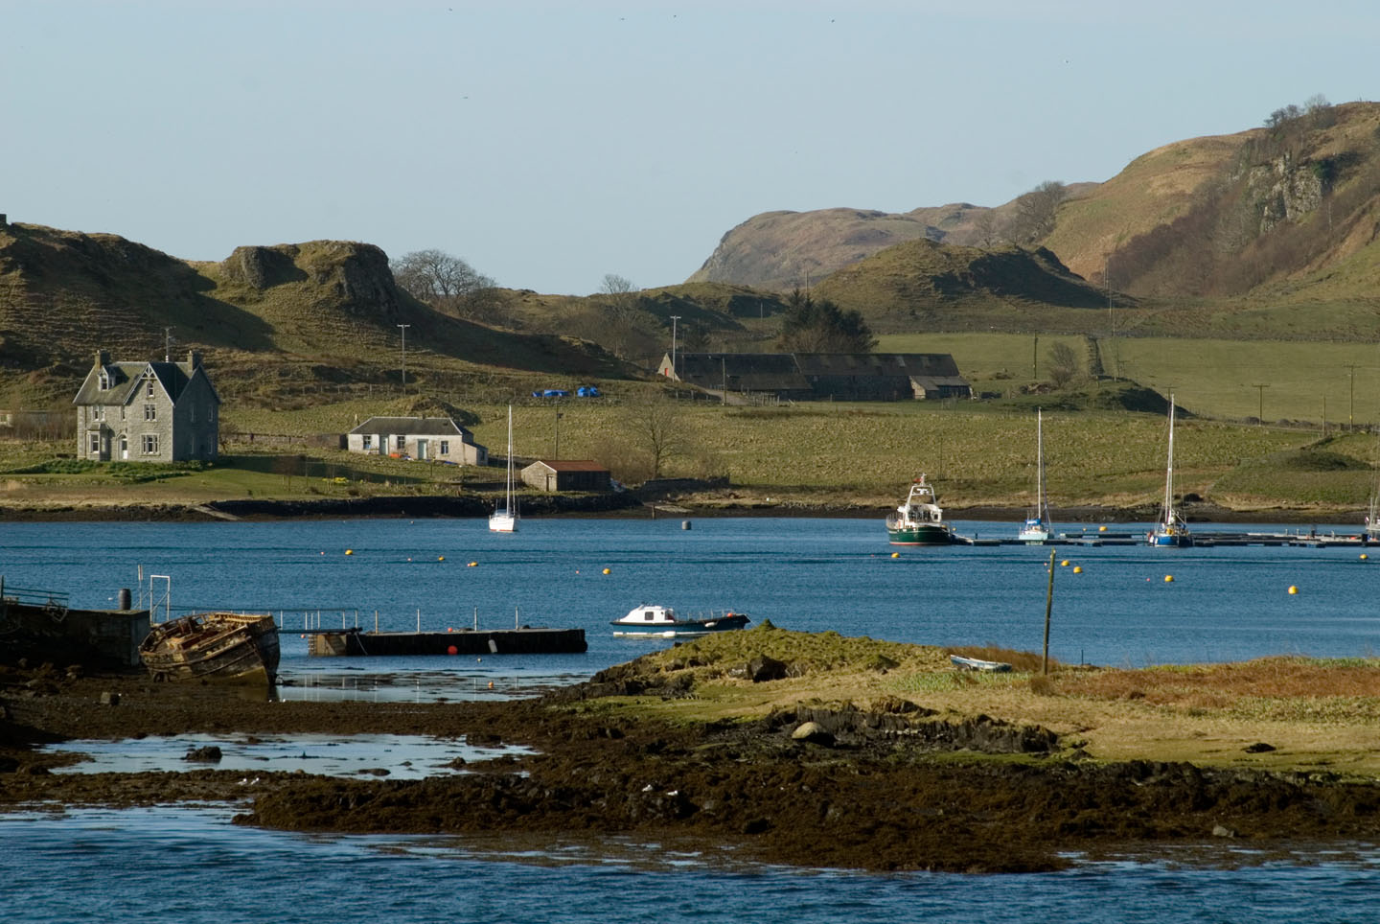
Title 2 – Limitation of liability or Safe Harbor

Slide 66
Online Copyright Infringement Liability Limitation
Added Section 512 to the Copyright Act
Defined new “safe harbors” for four kinds of online service provider activities
  Transitory digital network communications
  System Caching
  Information residing on systems at the direction of users
  Information location tools (search engines)
Notes:
These four activities cover a lot of the services that we rely on and perhaps even love today.

Slide 67
512 (a) Transitory digital network communications
Buy file on iTunes
iTunes server
iTunes proxy
iTunes router
AT&T router
Level 3 Router
Cable Modem
Temp
File
iTunes Library
Notes:
The first covers the kind of copying that we’re never, ever aware of, but without which the internet could not survive.
Here’s a partial list of copies that might be made in the process of a completely authorized user download of a copyrighted file purchased from iTunes. A file download makes a lot of hops from server to server as it travels around the world, and every time it hops a device makes a copy of it somewhere, even as another device throws away its copy. Without this safe harbor, it might have been possible to pursue any network service provider for infringement, or even Cisco for making routers.

Slide 68
512 (b) System caching
Sender attaches file to e-mail
E-mail server stores file
Recipient downloads attachment
Notes:
The second safe harbor covers similar behavior that isn’t transitory. An e-mail provider, for instance, can’t discard an attachment until the recipient has downloaded it. That’s different from a router, which throws away data as soon as it can.

Slide 69
512 (c) Information residing on systems or networks at the direction of users
User uploads file
Service provider stores file
User downloads
file
Notes:
The third safe harbor is the one that you probably heard about in connection with the phrase, “DMCA Safe Harbor.” This is the provision that has helped YouTube prevail over Viacom to date, and on which Twitter, Facebook, and countless other image and video hosts rely.
Like the others, this safe harbor carries with it some obligations.

Slide 70
512(d) Information location tools
Site hosts infringing materials
Search engine indexes site
User searches for materials
Search engine shows link
Notes:
The fourth Safe Harbor specifically exempts search engines and so on from liability when linking to sites with infringing material, as opposed to actually hosting it.
This provision is subject to the same conditions as the third.

Slide 71
Third and Fourth Safe Harbors -
Qualifying for the exemption
No actual knowledge of infringing files
  Not aware of facts and circumstances from which infringing activity is apparent
No financial benefit from the infringing activity directly
Acts to take down infringing material when notified
Notes:
And yet, you can google for the Pirate Bay, and there it is.

Slide 72
So why can you find Pirate Bay on Google?
Pirate Bay is not hosted in the US
  Wouldn’t qualify for service provider protection
The rightsholder has to notify about infringement
  Perfect 10 v. CCBill
  Viacom v. Google
Google doesn’t have to build a list of infringing sites
A torrent file can be infringing, a page that links to one may not be
Notes:
First, Pirate Bay absolutely gets no slack from the DMCA, which is based on the same WIPO requirements as the Swedish law under which the founders were sentenced to jail. It’s exactly the type of site that the exclusions to the third and fourth safe harbors were aimed at.
Next, there have been a number of cases interpreting the “does know” and “oughta know” provisions. Perfect 10 v CCBill established that the burden of identifying infringement falls on the rights owner, and Viacom v. Google reinforced that.
Google, Twitter, Facebook routinely receive and process takedown notifications for specific files. Google indexes Pirate Bay pages, but not the torrent links, as far as I could tell in my research.

Slide 73
DMCA Outcomes – Key Takeaways
Controversial
  Particularly anti-circumvention, but also safe harbor
Anti-circumvention has had limited effect
  Individual technologies, not circumvention as a whole
Safe harbor provisions have had substantial effect
Notes:
I am confident that the outcome of DMCA has been totally different from the nightmare envisioned by technologists back in 1998.
I was one of those worried technologists, and looking around today I am surprised at the actual outcomes.
The safe harbor provisions have provided “good citizen” tech innovators with strong protections.
Anti-circumvention law has not made it impossible to implement innovative technical solutions.
So what of the future?

Slide 74
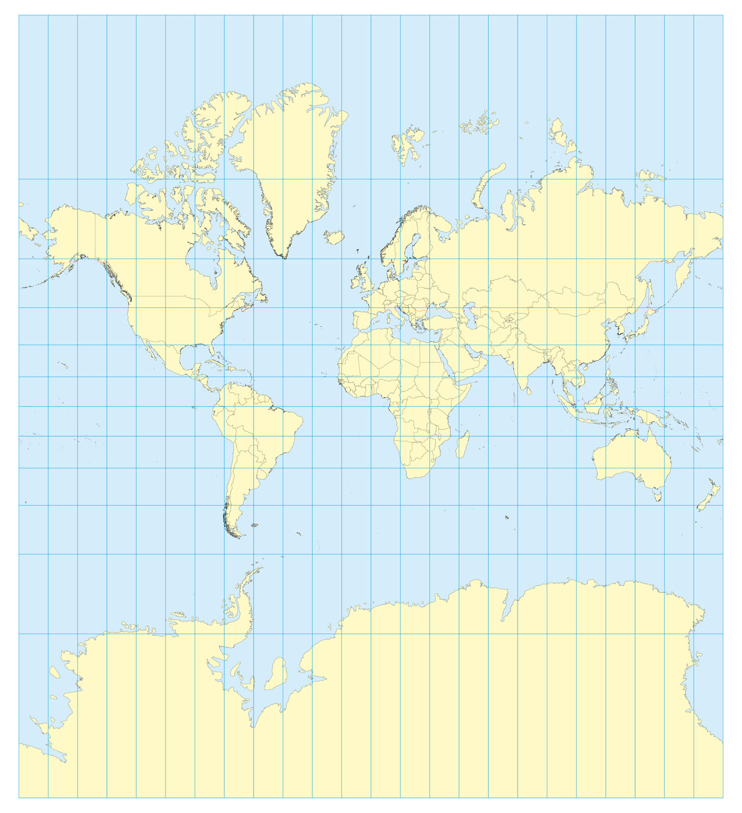
COICA/PIPA/PROTECT-IP/SOPA
The new controversy
Attempt to act against foreign hosts
  Delisting, delinking from
  US-based service providers
  Identifies specific technical
  countermeasures
On hold after widespread protests
Notes:
As we see with anti-circumvention and The Pirate Bay, difficult for a US law to be applied world wide.
Easier to move a website than to extradite and prosecute; there are web hosts in some countries that promise immunity for lists of illegal activities
The COICA/PIPA/PROTECT-IP/SOPA sequence of legislation has sought to act against foreign hosts by taking action against service provider companies, seeking to cut off access to search engines, the domain name system, and payment services.
Even more controversial than DMCA, so far all are on hold

Slide 75
Innovation
Notes:
The cycle repeats itself – after innovation, litigation and legislation, the wheel turns back to innovation.
For our final topic, we’re going to take a look at one of Betamax’s many technical – and legal - descendants.
I find this case – and its innovation – inspiring, as it shows an effective combination of technical expertise and understanding of copyright, delivering a solution that ultimately withstood legal challenges and delivered significant value to the customer.

Slide 76
Betamax Redux
Time shifting as fair use
  In home, private and personal use
  Noncommercial
Could a company provide a service that offered time-shifting to its paying customers?
In 2006, Cablevision decided to find out
Notes:
Tivo had shown new ways to use digital recording technology to enhance the viewing experience with an additional device connected to the user’s TV and set-top box. Cablevision wanted to offer some similar benefits to its cable TV customers without requiring an additional device. Cablevision designed its network based digital video recording system, RS-DVR, to deliver those benefits, and did its best to do so without trespassing on infringing behavior.

Slide 77
Remote Storage Digital Video Recorder (RS-DVR)
Video Server
Cable Head-end
Channel Splitter
Video Server
Video Server
Video Server
Video Server
Video Server
Set Top Box
Set Top Box
TV
TV
Notes:
A normal cable media stream contains a huge number of channels, all mixed together, all of them going down from the central office to every set-top box.
RS-DVR split that stream at the central office, so that one copy of the stream continued as usual.
The other was split up into individual channels and sent to video servers, each of which kept a running three-frame cache of the video – around a twentieth of a second.

Slide 78
Remote Storage Digital Video Recorder (RS-DVR)
Cable Head-end
Channel Splitter
Video Server
Set Top Box
TV
Notes:
When a user triggered a recording request with her remote, the video server for that channel started hanging on to those running frames of video, creating a copy of that show that would be used only by that one customer. If many customers ask to record the same show, the system would keep one copy for each.

Slide 79
Remote Storage Digital Video Recorder (RS-DVR)
Cable Head-end
Channel Splitter
Video Server
Set Top Box
TV
Notes:
When the customer triggers the saved copy for playback, the head-end encrypts that stream of video and sends it into the stream of all channels, using a key that only that one customer can decrypt.
The whole process is completely automatic, giving Cablevision the ability to argue that it’s the customer’s personal use, even though they’re making the copy and charging for the service.
Naturally, because this was an attempt to expand the reach of technology into existing use of copyright, they were sued.

Slide 80
Twentieth Century Fox Film v. Cablevision Sys.
District Court ruled infringing
Appeals Court reversed –
non-infringing under Sony
Twentieth Century Fox Film v. Cablevision Sys.- 2007-2008
Notes:
The judge in the initial trial ruled that the Sony precedent didn’t apply.
This was Judge Chin who is currently still presiding over the Google book scanning trial, by the way.
He ruled that RS-DVR was very different from Sony; Sony concerned a single device, owned by the customer, while RS-DVR concerned a whole host of equipment, all owned by Cablevision. RS-DVR wasn’t a product sold over the counter, to be used as the customer determined, but a commercial service.
The appeals court reversed, and ruled that it was the customer’s decision to copy that created the copy, and that that personal use fit under fair use.
What I like about this sequence is how….[next page]

Slide 81
Cablevision and Sony
Designed to fit existing law
Respected existing usage models
  Didn’t seek to authorize obviously infringing use
Prepared for litigation
Good citizen behavior
  no “our customers are pirates” e-mails
Notes:
They didn’t act like cowboys, let alone cattle rustlers. They simply implemented a system and asked the question, what makes this infringing? Is it the length of the wire? And made their arguments.
They created a new service and delivered a terrific new benefit, and carefully crafted it to fit into copyright law. There’s engineering excellence here, as well as solid understanding of copyright law.
Further cases have established that it’s OK to compress the separate copies, the way any system operator would.

Slide 82

Copyright for Innovators

Slide 83
What can we learn from this?
Copyright is copyright
What affects
  TV
  Movies
  Music
Affects books and publishing in the same way

Slide 84
Random House v. Rosetta - 2001
Rosetta agreed to eBooks by established authors
  Books published long before digital publication was established
Random House sued
  Exclusive rights to “print, publish, and sell in book form”
  Argued that “book form” included eBooks
  Sought an injunction to stop Rosetta from proceeding
Injunction denied at trial and appeal
Rosetta and Random House settled
Notes:
Back in 2001, there was already action on eBooks.
Random House sought to prevent an ebook publishing startup from distributing ebook editions of some of its backlist works.
In this case, though, we didn’t get a decision that tied everything up and put a bow on it, like Sony.
The central question – does the old book form language include ebooks – wasn’t really settled at trial.

Slide 85
eBooks and “in Book Form”:
The digital battleground for the print backlist
2001
Random House v. Rosetta
2010
Odyssey Editions
2011
Open Road publishes Julie of the Wolves
Harper sues for copyright infringement
Settlement
Removes Random House titles after pressure
Notes:
It’s clear at this point that the industry needs an answer to the question about print backlist rights.
It will be interesting to see whether we get an equivalent to the Sony case in print.
The big difference for print is individual ownership of rights by authors – it’s a lot easier for a Sony or a Universal Studios to litigate for years, than it is for an author or even a literary agency.
In the meantime, though, I don’t think that the world sitting around, waiting to see what happens.

Slide 86
Copyright in motion
Technology changes
  Copyright follows
How do we succeed?
  Walk carefully on new ground, like Sony
  Help the law catch up, like Cablevision
  Know what rights we own
  Understand new technologies, study new legislation
And keep pushing ahead!

Slide 87
Thank you
Skott Klebe
Ed Colleran
Copyright Clearance Center
sklebe@copyright.com
ecolleran@copyright.com

